Slide 1
Regression Analysis
Simple Linear Regression
Nicoleta Serban, Ph.D.
Professor
School of Industrial and Systems Engineering
Regression Concepts: Estimation

Slide 2

About This Lesson

Slide 3
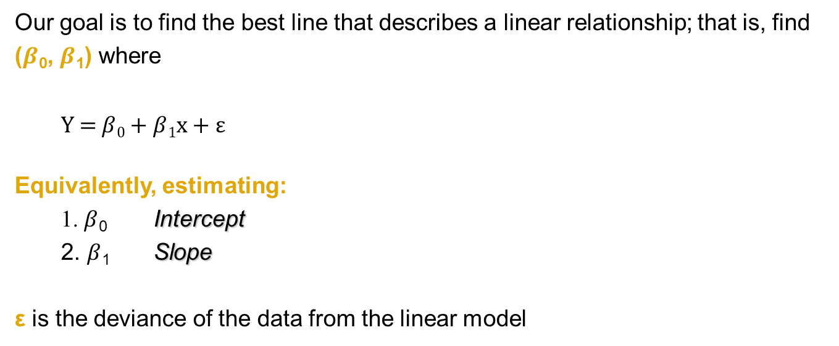
Simple Linear Regression: Model
Our goal is to find the best line that describes a linear relationship; that is, find ($β$₀, $β$₁) where
Y = $β$₀ + $β$₁x + $\text{ε}$
Equivalently, estimating:
1. $β$₀ Intercept
2. $β$₁ Slope
$\text{ε}$ is the deviance of the data from the linear model

Slide 4
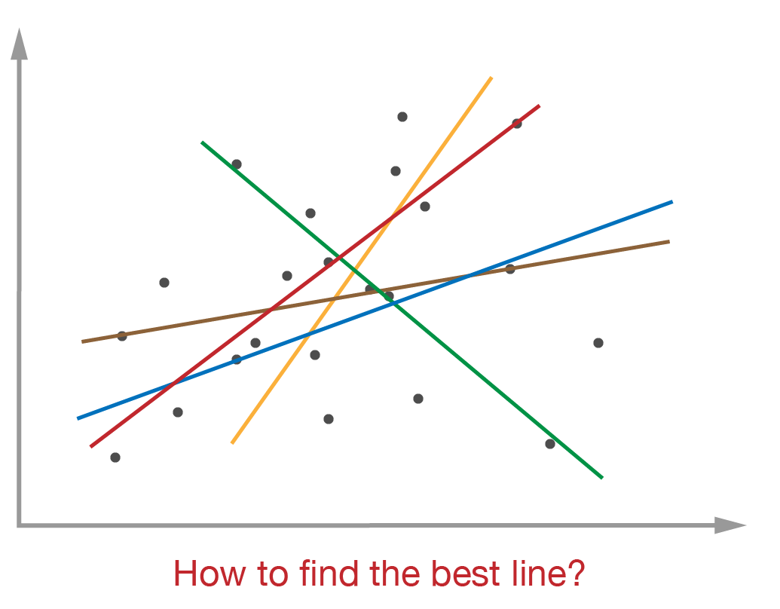
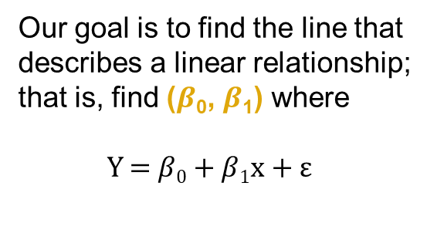
Simple Linear Regression: Model
Our goal is to find the line that describes a linear relationship; that is, find ($β$₀, $β$₁) where
Y = $β$₀ + $β$₁x + $\text{ε}$

Slide 5
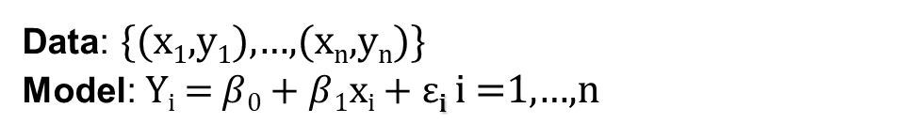
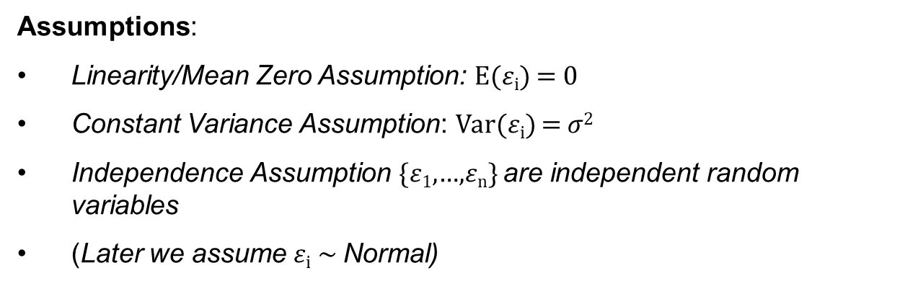
Simple Linear Regression: Model
Data: {(x₁,y₁),…,(x_{n},y_{n})}
Model: Y_{i} = $β$₀ + $β$₁x_{i} + $\text{ε}$_{i} i =1,…,n
Assumptions:
Linearity/Mean Zero Assumption: E($ε$_{i}) = 0
Constant Variance Assumption: Var($ε$_{i}) = $σ$²
Independence Assumption {$ε$₁,…,$ε$_{n}} are independent random variables
(Later we assume $ε$_{i} ~ Normal)

Slide 6

Simple Linear Regression: Model
Data: {(x₁,y₁),…,(x_{n},y_{n})}
Model: Y_{i} = $β$₀ + $β$₁x_{i} + $\text{ε}$_{i} i =1,…,n
The model parameters are: $β$₀ , $β$₁ $, σ$²
Unknown regardless how much data are observed
Estimated given the model assumptions
Estimated based on data
Assumptions:
Linearity/Mean Zero Assumption: E($ε$_{i}) = 0
Constant Variance Assumption: Var($ε$_{i}) = $σ$²
Independence Assumption {$ε$₁,…,$ε$_{n}} are independent random variables
(Later we assume $ε$_{i} ~ Normal)

Slide 7
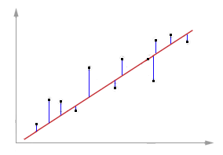
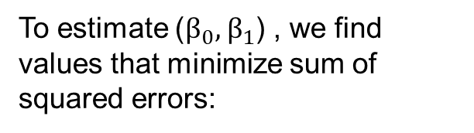
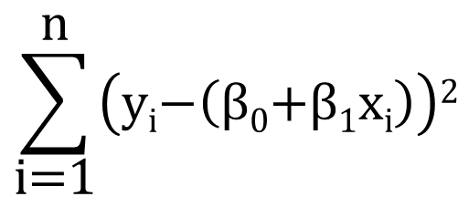
Model Estimation: Approach
To estimate ($β_{0},$ $β_{1}$) , we find values that minimize sum of squared errors:
$$\sum_{\text{i}\text{=1}}^{\text{n}}{\left(\text{y}\text{i}\text{−}\left(\text{β}\text{0}\text{+}\text{β}\text{1}\text{x}\text{i}\right)\right)\text{2}}$$

Slide 8
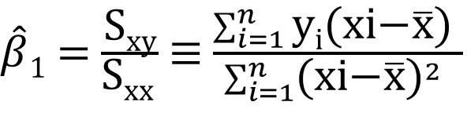
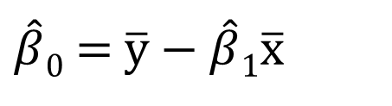
Model Estimation: Approach
To estimate ($β$₀, $β$₁), we find values that minimize squared error:
$$\sum_{\text{i}\text{=1}}^{\text{n}}{\left(\text{y}\text{i}\text{−}\left(\text{β}\text{0}\text{+}\text{β}\text{1}\text{x}\text{i}\right)\right)\text{2}}$$
$\hat{β}0$ = $\overline{\text{y}}\text{ −} \hat{β}1\overline{\text{x}}$
$\hat{β}1$ = $\frac{\text{S}\text{xy}}{\text{S}\text{xx} }$ $≡$ $\frac{\sum_{i=1}^{n}{\text{y}\text{i}\text{(}\text{xi}\text{−}\overline{\text{x}}\text{)}} }{\sum_{i=1}^{n}{{\text{(}\text{xi}\text{−}\overline{\text{x}}\text{)}}^{2}} }$

Slide 9
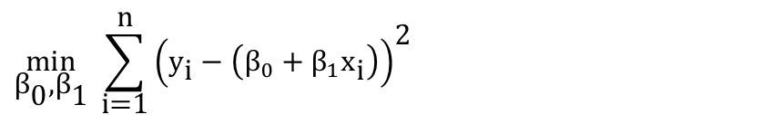


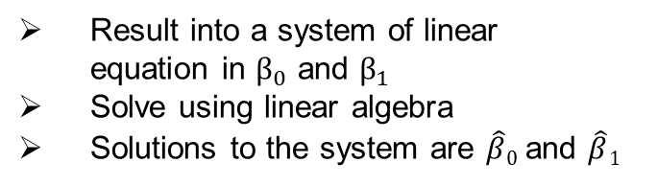
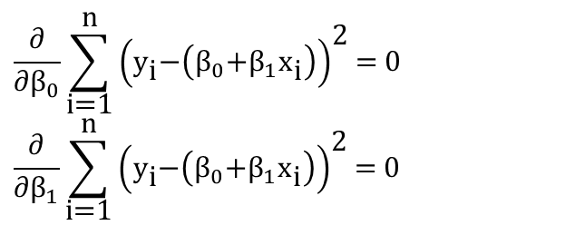
Model Estimation: Approach
$$\underset{{\text{β}}_{\text{0}}\text{,}{\text{β}}_{\text{1}}}{\text{min}}{ \sum_{\text{i}\text{=1}}^{\text{n}}{{\left({\text{y}}_{\text{i}} \text{−} \left({\text{β}}_{0} \text{+} {\text{β}}_{1}{\text{x}}_{\text{i}}\right)\right)}^{\text{2}}}}$$
Begin with the minimization problem:
$$\frac{\text{∂}}{\text{∂}{\text{β}}_{0}}\sum_{\text{i}\text{=1}}^{\text{n}}{{\left({\text{y}}_{\text{i}}\text{−}\left({\text{β}}_{0}\text{+}{\text{β}}_{1}{\text{x}}_{\text{i}}\right)\right)}^{\text{2}}}\text{=} \text{0}$$
$$\frac{\text{∂}}{\text{∂}{\text{β}}_{1}}\sum_{\text{i}\text{=1}}^{\text{n}}{{\left({\text{y}}_{\text{i}}\text{−}\left({\text{β}}_{0}\text{+}{\text{β}}_{1}{\text{x}}_{\text{i}}\right)\right)}^{\text{2}}}\text{=} \text{0}$$
To solve, take the first order derivatives of the function to be minimized and equate to 0:
Result into a system of linear equation in ${\text{β}}_{0}$ and ${\text{β}}_{1}$
Solve using linear algebra
Solutions to the system are $\hat{β}0$ and $\hat{β}1$
$\hat{β}0$ = $\overline{\text{y}}\text{ −} \hat{β}1\overline{\text{x}}$
$\hat{β}1$ = $\frac{\text{S}\text{xy}}{\text{S}\text{xx} }$ $≡$ $\frac{\sum_{i=1}^{n}{{\text{y}}_{i}\text{(}{\text{x}}_{i}\text{−}\overline{\text{x}}\text{)}} }{\sum_{i=1}^{n}{{\text{(}{\text{x}}_{i}\text{−}\overline{\text{x}}\text{)}}^{2}} }$

Slide 10
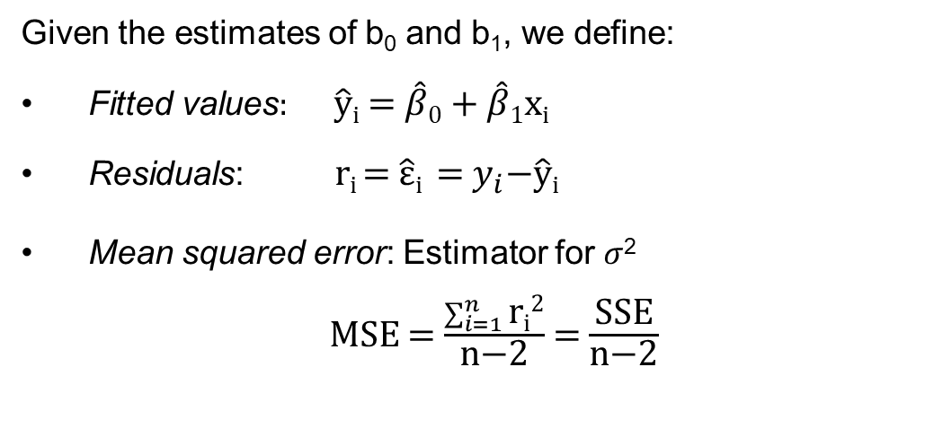
Fitted Values and Residuals
Given the estimates of b₀ and b₁, we define:
Fitted values: $\hat{y}i$ = $\hat{β}0$ + $\hat{β}1$x_{i}
Residuals: r_{i} = $\hat{ε}i \text{= }y_{i}\text{−}\hat{y}i$
Mean squared error: Estimator for $σ$²
MSE = $\frac{\sum_{i=1}^{n}{\text{r}\text{i}\text{2}}}{\text{n}\text{−2}}$ = $\frac{\text{SSE}}{\text{n}\text{−2}}$

Slide 11
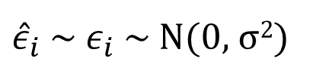

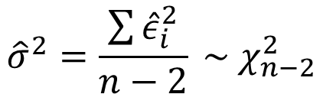
Variance Sampling Distribution
$${\hat{σ}}^{2}=\frac{\sum{{\hat{ε}}_{i}^{2}}}{n−2} \sim χ_{n−2}^{2}$$
(chi-squared distribution with n-2 degrees of freedom)
Assuming
${\hat{ε}}_{i}$~ $ε_{i}$ ~ N(0, $\text{σ}$²)
Estimating $\text{σ}$² Sample variance

Slide 12
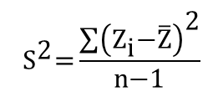
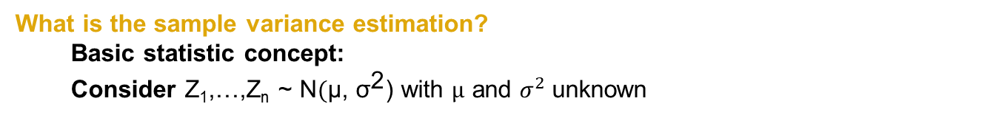
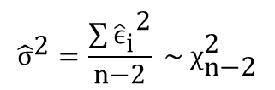
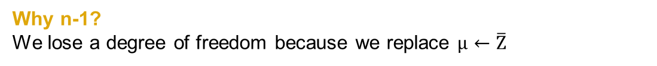
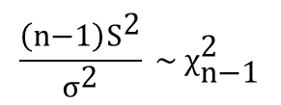
Variance Sampling Distribution (cont’d)
What is the sample variance estimation?
  Basic statistic concept:
  Consider Z₁,…,Z_{n} ~ N$(\text{μ}\text{, }{\text{σ}}^{\text{2}}$) with $μ$ and $σ^{2}$ unknown
$${ \text{S}}^{\text{2}}\text{=}\frac{\sum{{\left({\text{Z}}_{\text{i}}\text{−}\overline{\text{Z}}\right)}^{\text{2}}}}{\text{n}\text{−1}}$$
$$\frac{\left(\text{n}\text{−1}\right){\text{S}}^{\text{2}}}{{\text{σ}}^{\text{2}}} \sim {\text{χ}}_{\text{n}\text{−1}}^{\text{2}}$$
The sample variance estimator:
Why n-1?
We lose a degree of freedom because we replace $μ←\overline{Z}$
$${\hat{\text{σ}}}^{\text{2}}=\frac{\sum{{{\hat{\text{ϵ}}}_{\text{i}}}^{\text{2}}}}{\text{n}\text{−2}} \sim {\text{χ}}_{\text{n}\text{−2}}^{\text{2}}$$
Now, going back to
This looks like the sample variance estimates except we use n-2 degrees of freedom. Why?

Slide 13




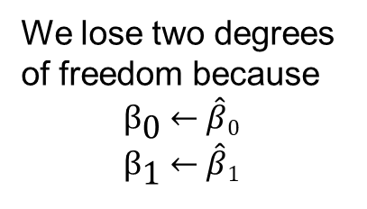
Variance Sampling Distribution (cont’d)
$${\text{ϵ}}_{\text{i}} \text{=} \left({\text{y}}_{\text{i}} \text{−} \left({\text{β}}_{\text{0}}\text{+}{\text{β}}_{\text{1}}{\text{x}}_{\text{i}}\right)\right)$$
Recall that
We lose two degrees of freedom because
$${\text{β}}_{\text{0}} \text{←} \hat{β}0$$
$${\text{β}}_{\text{1}} \text{←} \hat{β}1$$
Replaced by ${\hat{\text{ϵ}}}_{\text{i}} \text{=} \left({\text{y}}_{\text{i}} \text{−} \left(\hat{β}0 \text{+} \hat{β}1{\text{x}}_{\text{i}}\right)\right)$
$${ \text{ϵ}}_{\text{i}}\text{ \sim }\text{N}\left(\text{0,} {\text{σ}}^{\text{2}}\right)$$
Thus, assuming that
$${\hat{\text{σ}}}^{\text{2}} \text{=} \text{MSE} \sim {\text{χ}}_{\text{n}\text{−2}}^{\text{2}}$$
(This is called the sampling distribution of ${\hat{σ}}^{2}$)

Slide 14
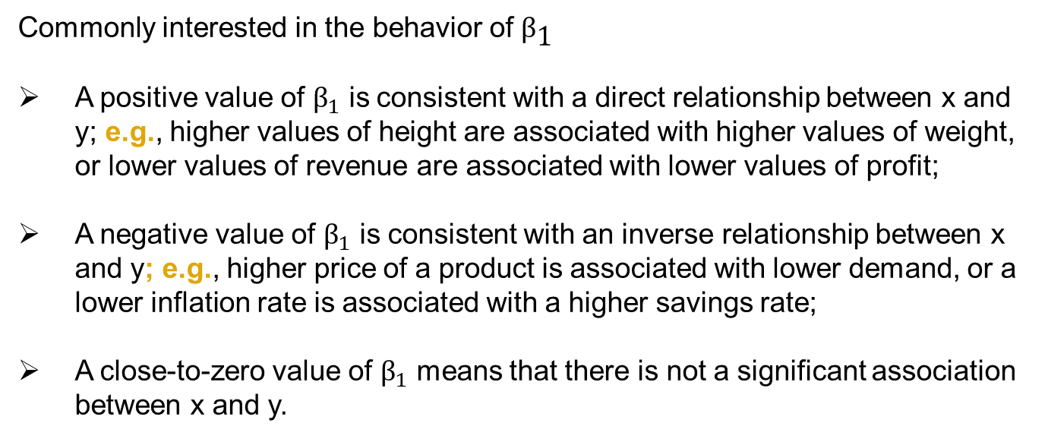
Model Parameter Interpretation
Commonly interested in the behavior of ${\text{β}}_{\text{1}}$
A positive value of ${\text{β}}_{1}$ is consistent with a direct relationship between x and y; e.g., higher values of height are associated with higher values of weight, or lower values of revenue are associated with lower values of profit;
A negative value of ${\text{β}}_{1}$ is consistent with an inverse relationship between x and y; e.g., higher price of a product is associated with lower demand, or a lower inflation rate is associated with a higher savings rate;
A close-to-zero value of ${\text{β}}_{1}$ means that there is not a significant association between x and y.

Slide 15
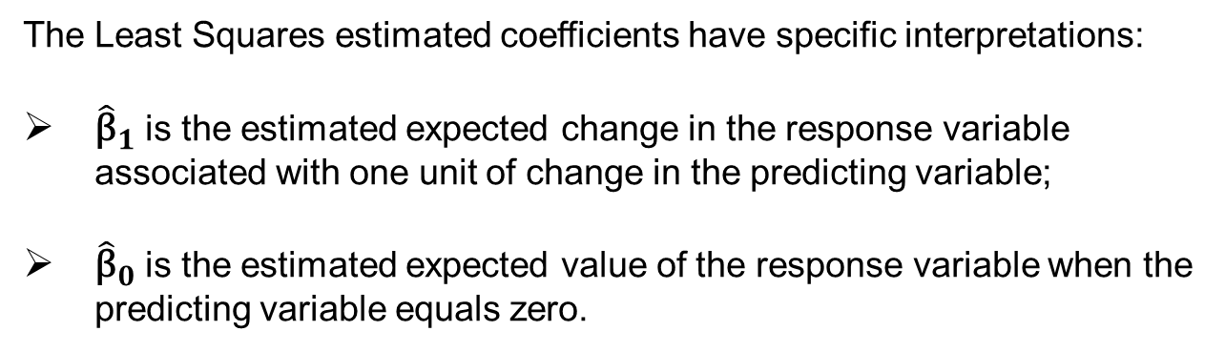
Model Estimate Interpretation
The Least Squares estimated coefficients have specific interpretations:
${\hat{\text{β}}}_{1}$ is the estimated expected change in the response variable associated with one unit of change in the predicting variable;
${\hat{\text{β}}}_{0}$ is the estimated expected value of the response variable when the predicting variable equals zero.

Slide 16

Summary

